Slide 1
SAL 603 Final Project
By: Roger Day
Research question: how do OPS+, Total bases, and hitter WAR correlate with a team's win percentage, runs scored, and run differential?
(analyzing MLB team data from 2021-2025.)

Slide 2
OPS+, Total Bases, & Hitter WAR (Predictor Statistics)
OPS+ is a statistic that measures OPS and normalizes it based on ballpark factors, with 100 being considered average and 125 being 25% better than league average. A team with an OPS+ of 105 or better is usually playoff quality.
Total Bases (TB) measures how many bases a batter advances on a hit. A team that accumulates 2275 or more total bases throughout a season is usually playoff quality.
Hitter WAR is a statistic that measures how many wins an offensive player adds to a team compared to a replacement-level player. A team with a hitter WAR of at least 24.0 is usually playoff quality.

Slide 3
W-L%, Runs Scored, & Run Differential (Outcome Statistics)
W-L% (Win/Loss Percentage) measures the percentage of games a team won throughout a season. A W-L% of 0.540 or 54% is usually playoff quality.
Runs scored measure how often a team scores. Teams that score at least 750 runs throughout a season are usually playoff quality.
Run differential measures how often a team scores and how often they are scored on. A run differential of about +70 is usually playoff quality.

Slide 4

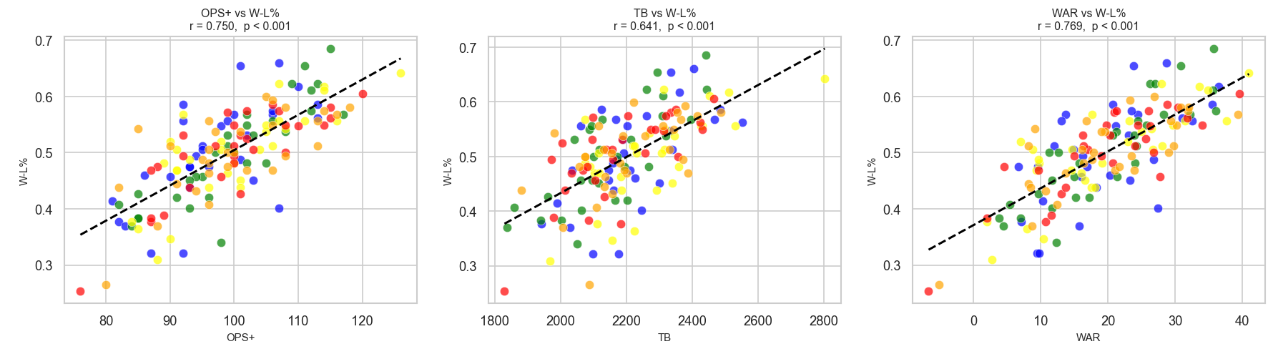

How W-L% Correlates with OPS+, Total Bases, and Hitter WAR

Slide 5
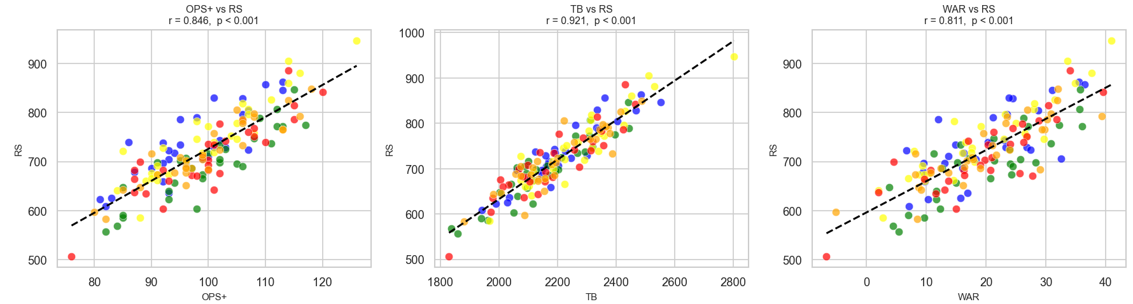
How Runs Scored Correlates with OPS+, Total Bases, and Hitter WAR

Slide 6
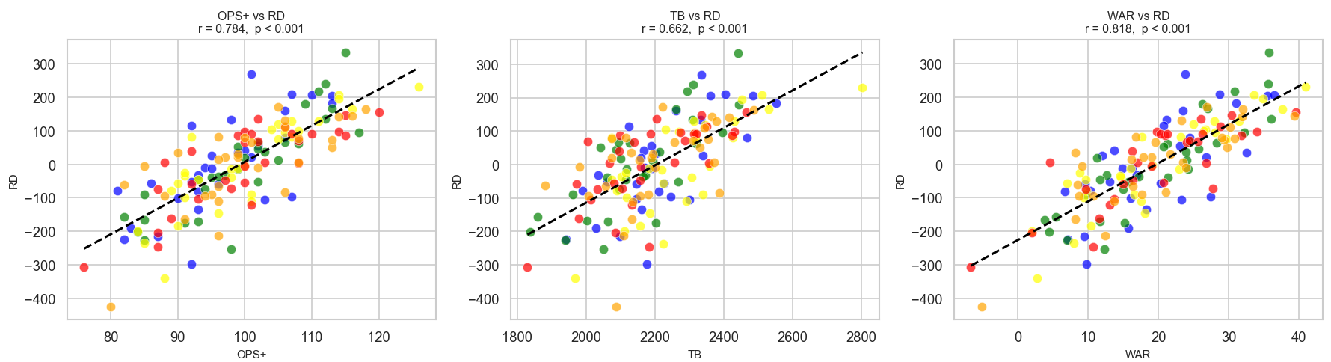
How Run Differential Correlates with OPS+, Total Bases, and Hitter WAR

Slide 7
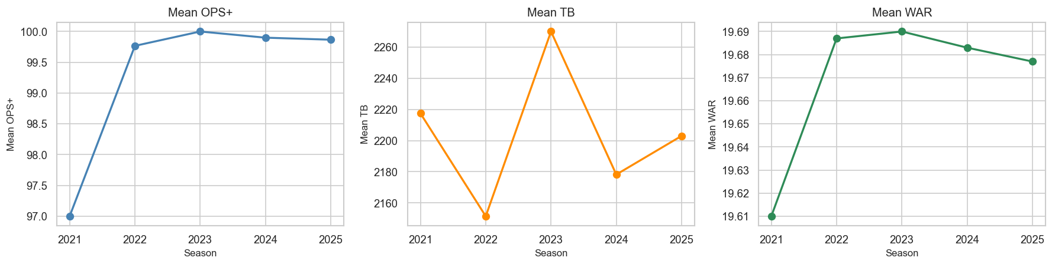
Mean OPS+, Total Bases, and Hitter WAR By Season

Slide 8
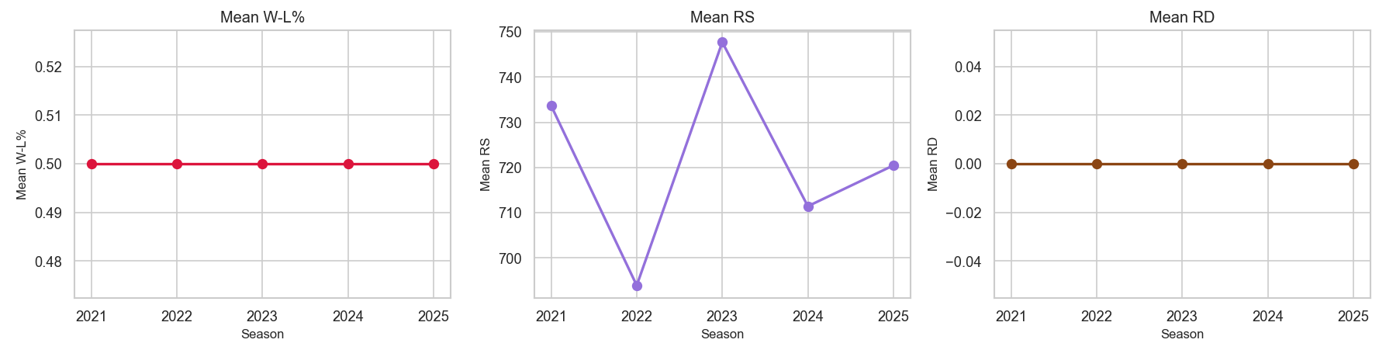
Mean W-L%, Runs Scored, and Run Differential

Slide 9
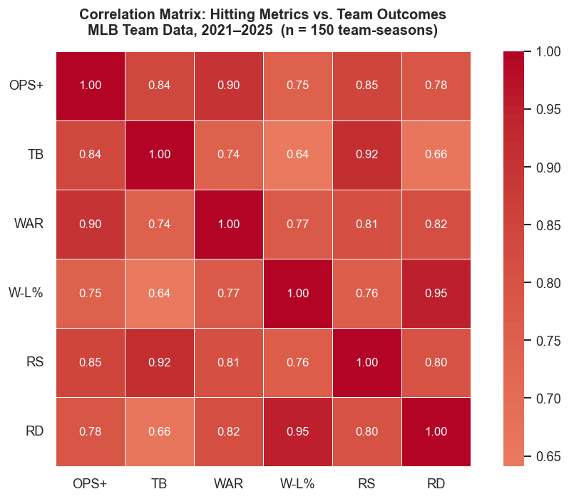
Correlation Heat Map

Slide 10
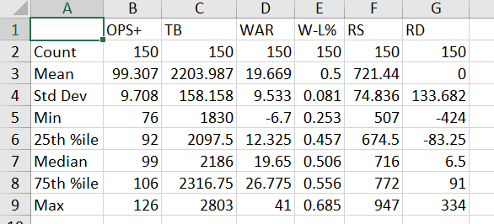
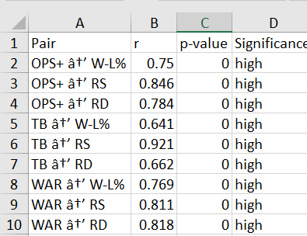
Data Table & Summary
mlb_full_dataset (1).pdf mlb_summary_statistics.csv mlb_correlations.csv

Slide 11
Links to code and pictures used
Week 8 Final Project.ipynb
correlation_heatmap.png
scatter_regression_plots.png
season_trends.png
(Pictures were cropped to help the flow of the presentation)

Slide 12
What does this Data Tell Us?

